Slide 1

Introduction to Fuel Cell Systems
Linnéa Strandberg
Department of Physics
Chalmers University of Technology Göteborg, Sweden

Slide 2
Learning outcomes
What a fuel cell is – fundamental principles and motivation
(a bit of) Electrochemistry
Electrode reactions, potentials, and current
Thermodynamics, efficiency and losses
Fuel cell components
Principles of components in the fuel cell system
Electrochemical testing and evaluation

Slide 3
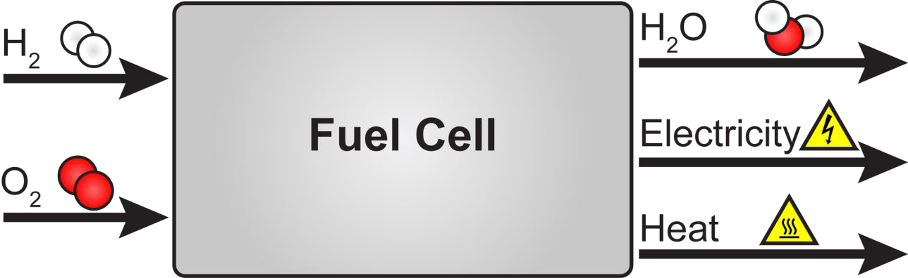
What is a fuel cell?
A Fuel Cell is a “factory” that converts chemical energy (fuel) to electricity (and heat). Delivers electricity as long as fuel is supplied (continuous operation).
An example, the H₂-O₂ fuel cell:
H₂ + ½O₂ → H₂O
Chemical Energy → Electrical Energy

Slide 4
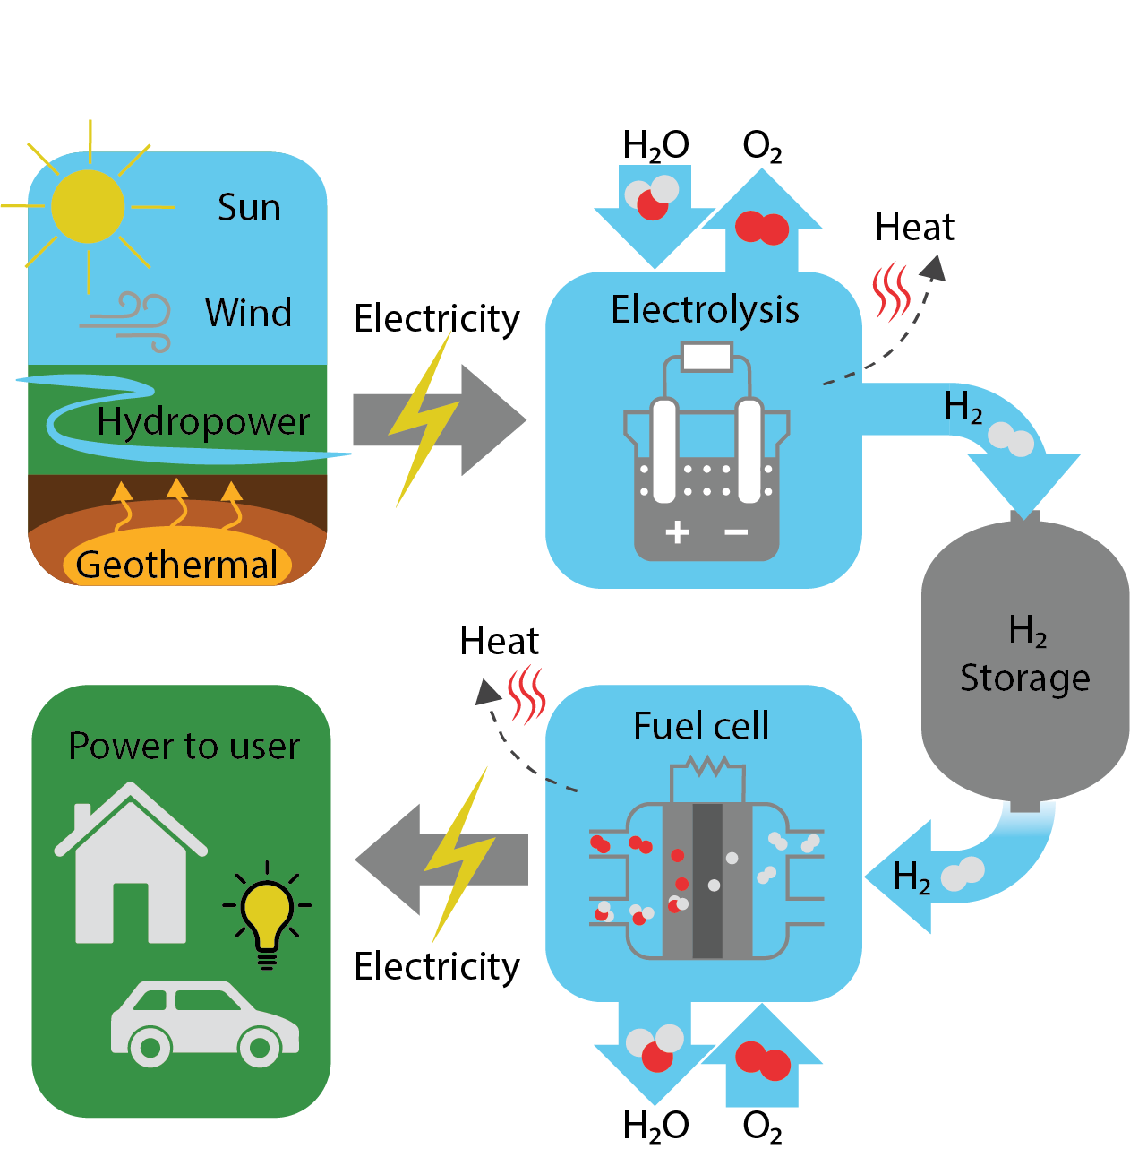
What is a fuel cell?
Similar to batteries, however FCs can run as long as fuel is provided externally
FCs have longer ranges, higher energy densities and faster refueling times as compared to battery technology
Many types of fuel cells
PEMFC:
Part of a sustainable energy system
Using Hydrogen as energy carrier
H₂ + ½O₂ → H₂O

Slide 5
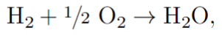
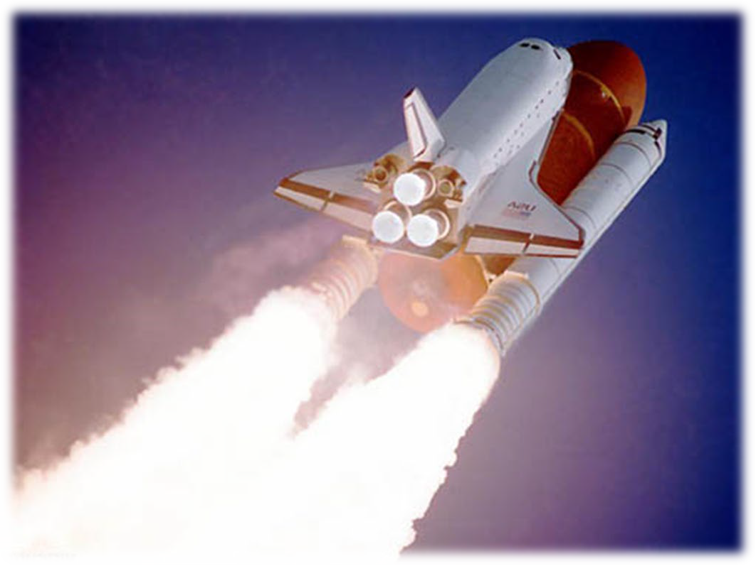
How does a fuel cell work?
A chemical combustion reaction:
Burning of Hydrogen:
(ΔH = -285.8 kJ/mol)
Combustion:
1.
2.
Molecules collide (H₂ and O₂) Bonds are broken/formed
H-H and O-O bonds are broken
H-O bonds are formed
Redistribution of electronic charge
Product is formed
3.
Takes place on the order of ps (10⁻¹²)
Energy difference is released as heat

Slide 6
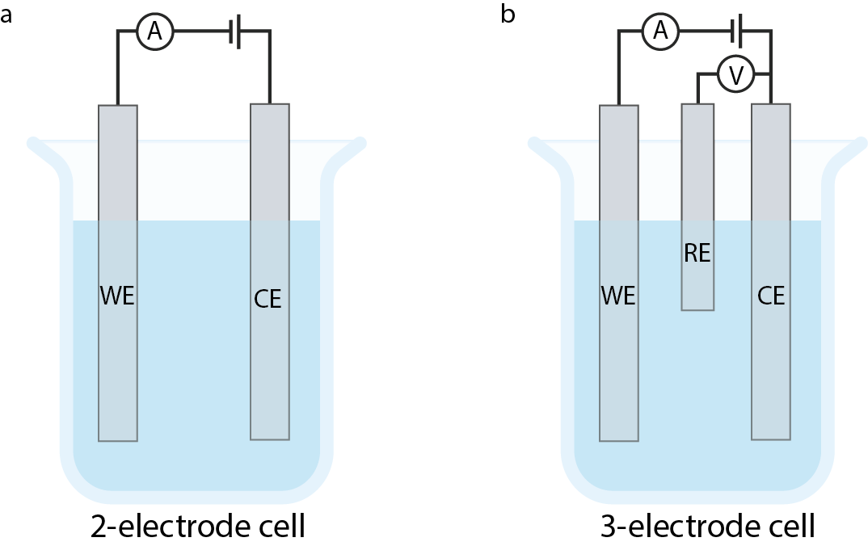
How does a fuel cell work?
Separate reactions in space!
e- →
Separating reactions allows us to use electrons to perform work before they are recombined
Anode
Cathode
H+→
Hydrogen oxidation reaction
Oxygen reduction reaction

Slide 7
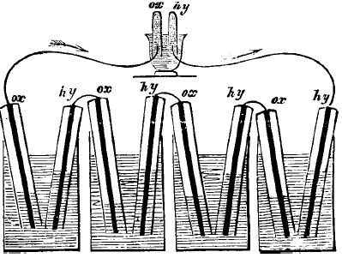
Fuel Cell History
1838/1839 Both Christian Friedrich Schönbein and William Robert Grove described the effect of fuel cell operation.
“Two strips of platinum 2 inches long and three-eighths of an inch wide, standing erect at a short distance from each other, passed, hermetically sealed, through the botton1 of a bell glass; the projecting ends were made to communicate with a delicate galvanometer; the glass was filled with water acidulated with sulphuric acid”
“The instant the tubes were lowered so as to expose part of the surfaces of platinum to the gases, the galvanometer needle was deflected so strongly as to turn more than half round : it remained stationary at 15°, the platinum in the hydrogen being similar to the zinc element of the pile.”
“After 24 hours, the water had risen half an inch in the tube containing hydrogen, and three eighths of an inch in that containing oxygen.” Grove, Phil. Mag. S. 3. Vol. 14. No. 86, Feb. 1839.
1842 William Robert Grove demonstrated that connecting cells in series produced a potential that could split water.
Grove, Phil. Mag. S. s. Vol. 21. No. 140. Dec. 1842.

Slide 8
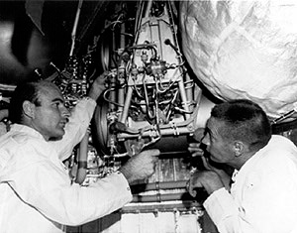
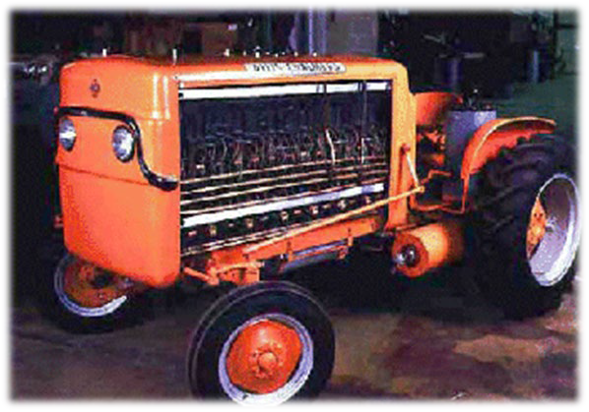
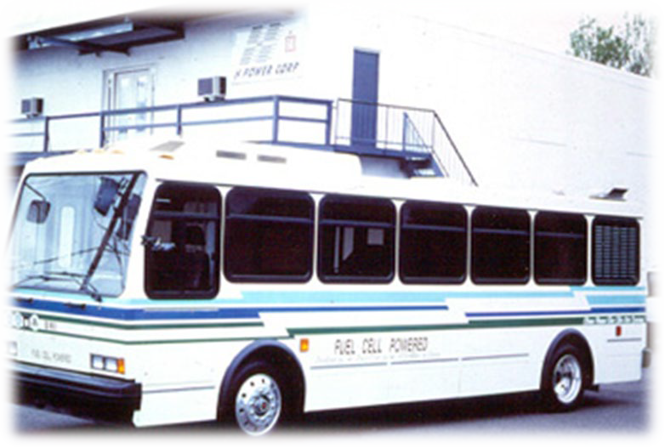


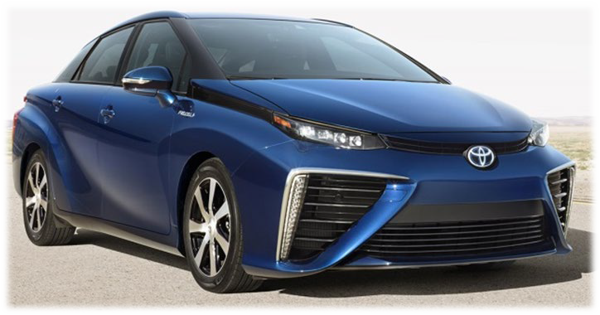
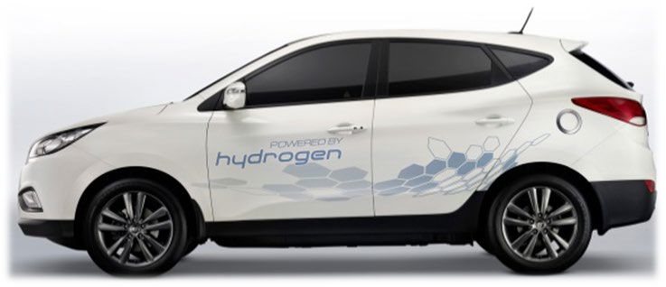
Fuel Cell History
1932-60 – Alkaline Fuel Cells, used in NASA’s Apollo space program. 1960-90 – First PEM Fuel Cell, used in the Gemini space program, Submarines etc.
1960 – Fuel cell powered tractor
1990 – Road test with Fuel Cell busses. Increased research
2000-2010 – Large technical improvements, new applications, promising tests, automotives, backup, portable power, etc.
2008 – “the year that fuel cells became true consumer products”
2013 – First commercial passenger cars

Slide 9
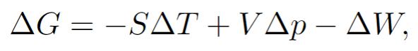
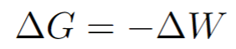
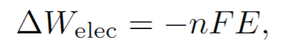
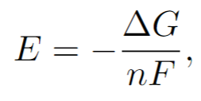
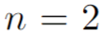
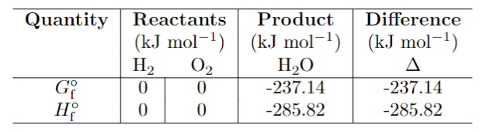
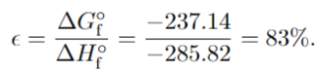
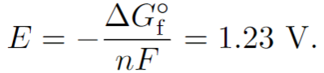
Thermodynamics
Gibbs free energy:
Constant temperature and pressure:
Electrical work done by cell:
Maximum work possible in a chemical process
n electrons transfered in process,
F faraday constant (charge per mole electrons)
E cell potenital
Maximum potential (all work is electrical work):
For hydrogen fuel cell:
Efficiency
@ Standard state (25 °C and 1 bar)

Slide 10

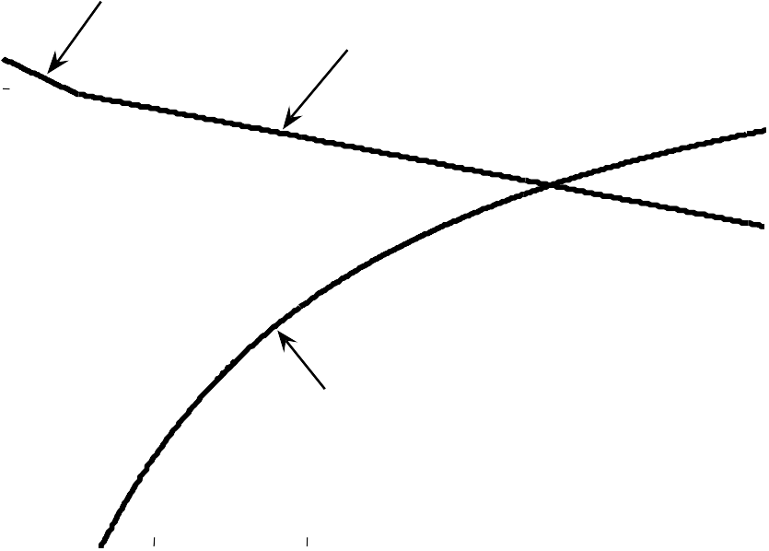
Efficiency limit of Fuel Cells
1
FC, liquid product
Theoretical limit
0.9
FC, steam product
0.8
ε
0.7
100% efficiency → E = 1.48 V
(No heat loss)
Operating efficiency ε = E
Efficiency,
0.6
0.5
1.48
0.4
Carnot limit, 50 º C exhaust
0.3
0.2
0
200
400 600
Operating Temperature [ º C]
800
1000

Slide 11
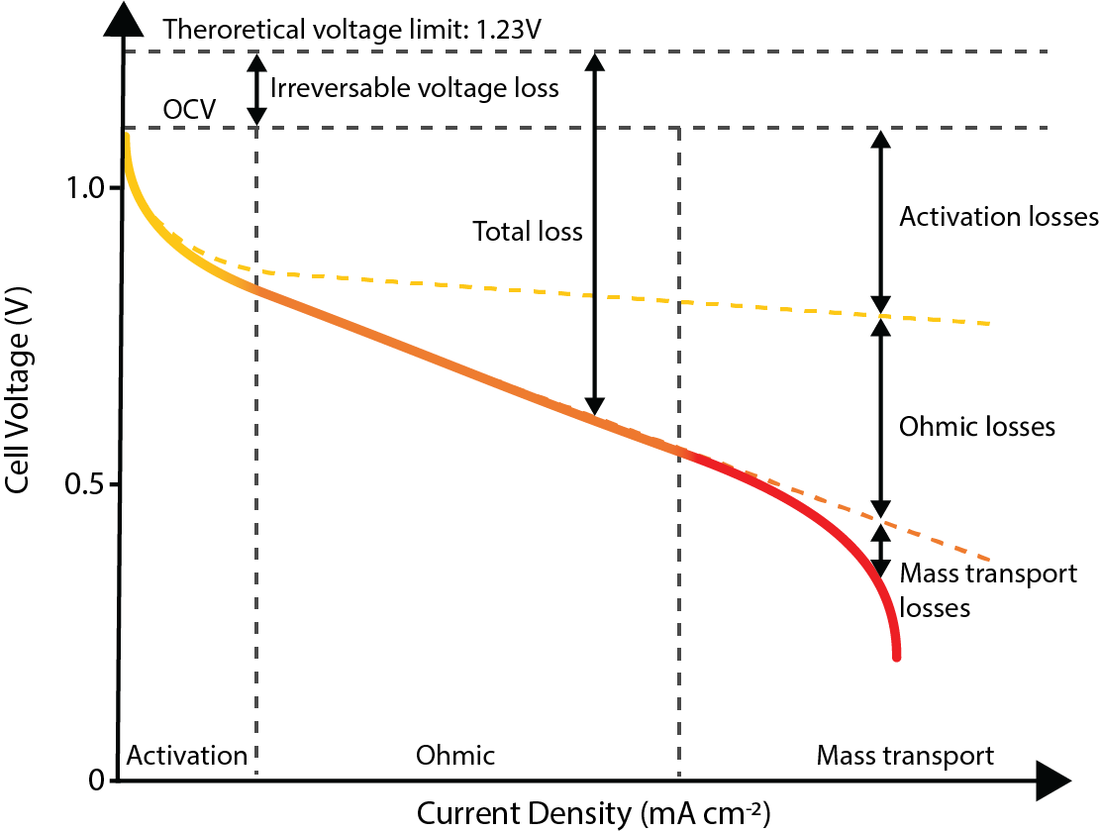
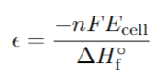
Losses
Real efficiency
(Not included losses
of unused fuel)

Slide 12
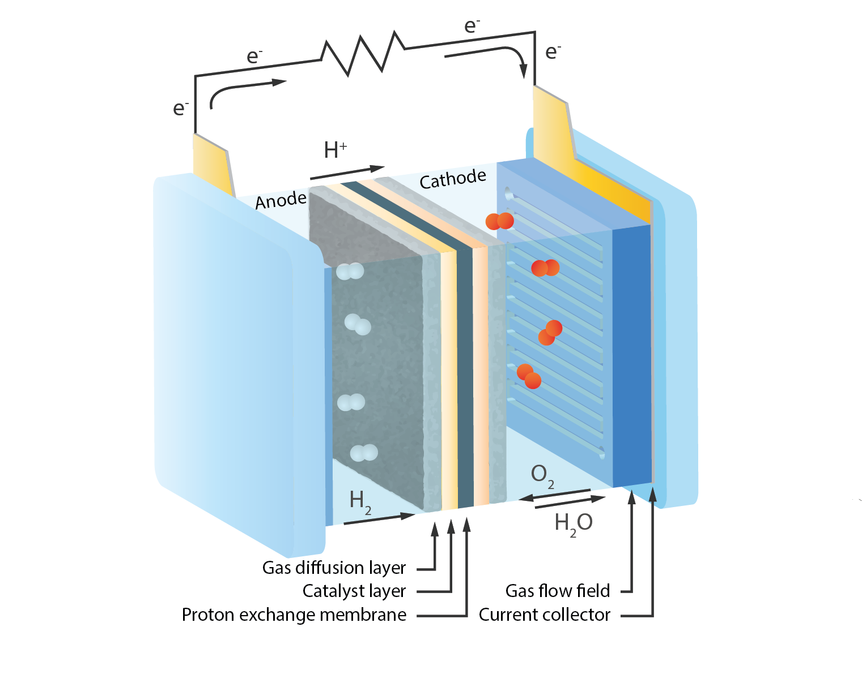
PEMFC structure

Slide 13
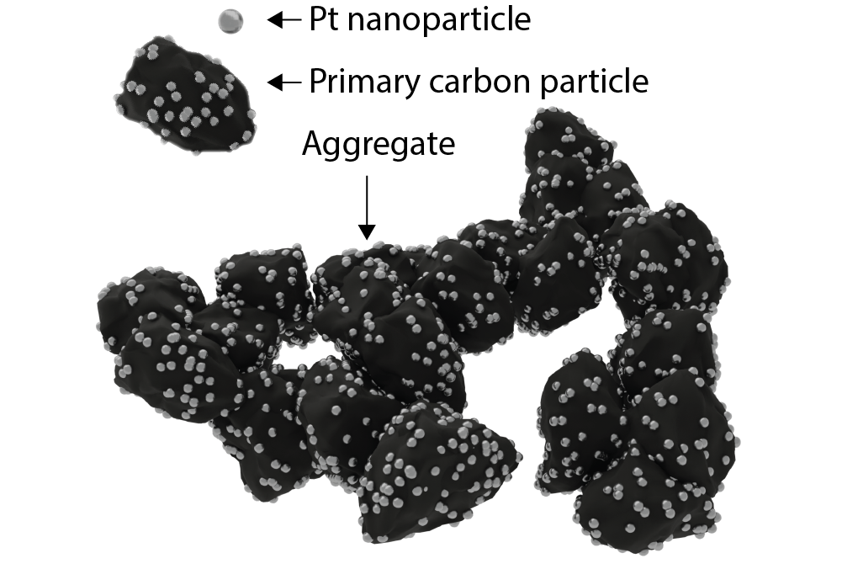
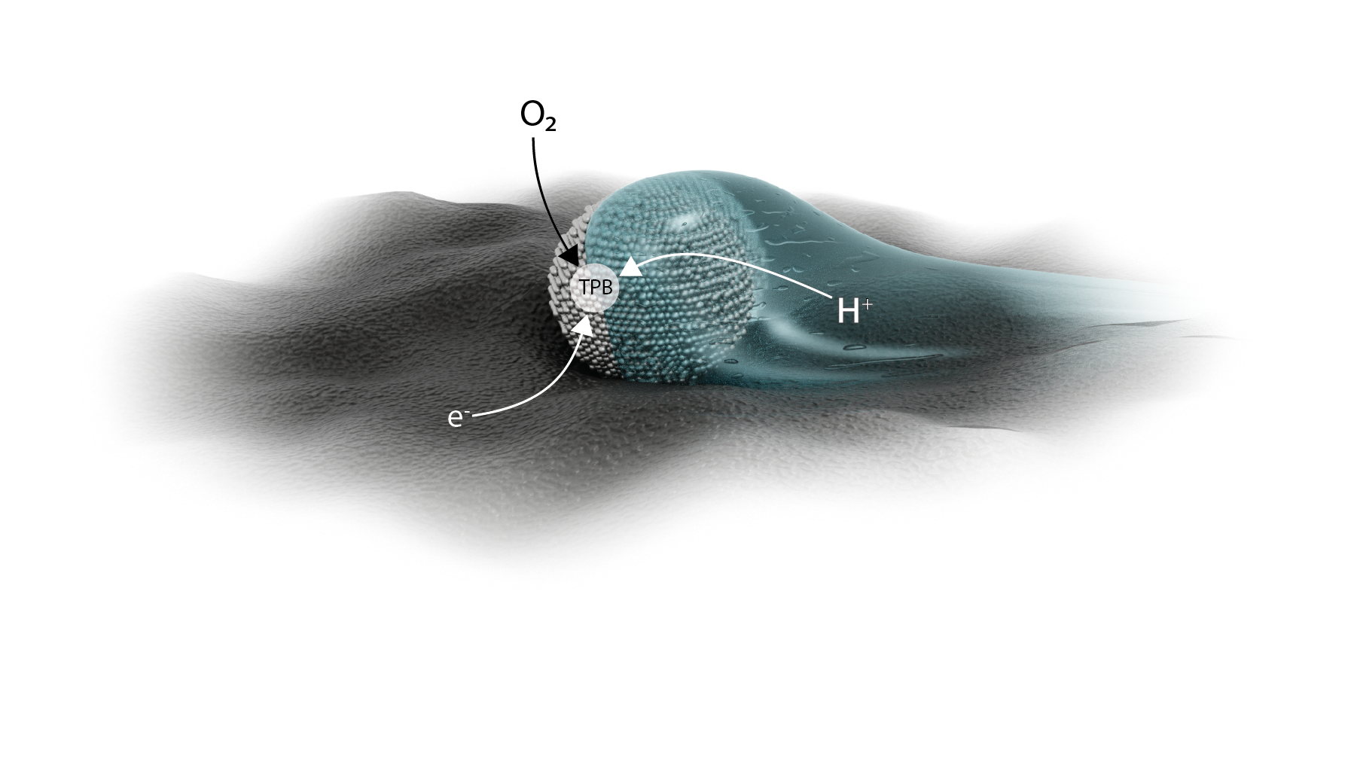
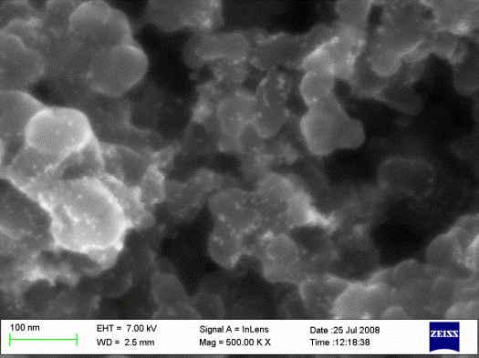
Catalyst layer/Electrodes
Where the reactions happens
Catalyses reactions, speed up process
Industry standard Pt/C
Catalyst Pt:
High activity
Small nanoparticles → large surface area
Carbon support:
High surface area, support Pt
Porous structure (gas transport)
electrically conductive
Ionomer:
Allows for ion transport (H⁺ ions)
Tripple phase boundary:
Physical location/phase boundary where
Oxygen, H+ ions and electrons can react

Slide 14
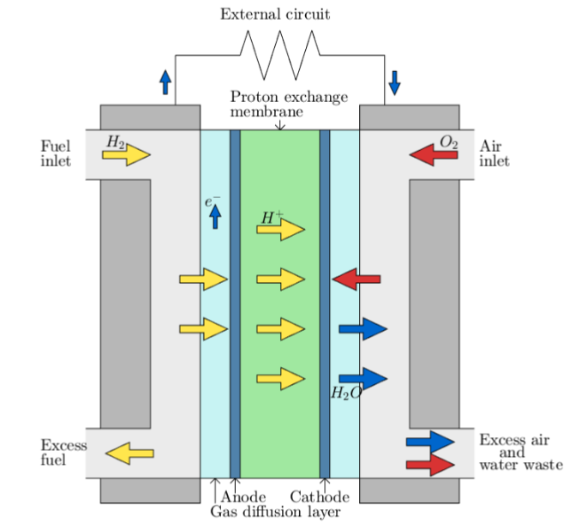
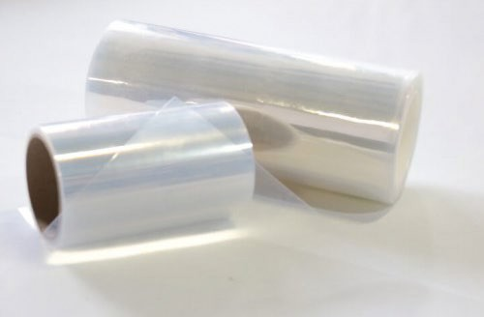
Proton exchange membrane
Separates half reactions
Conducts ions (H+) from anode to cathode
Prevents gas crossover
Electrically insulating
Ionomer: ion conductive polymer

Slide 15
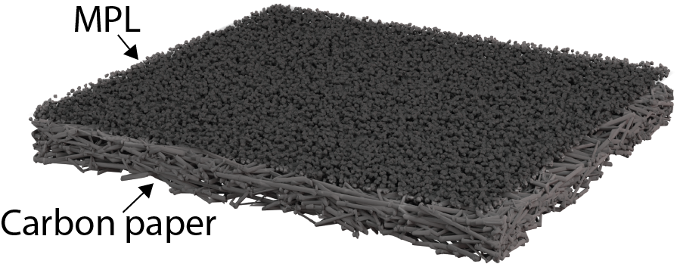
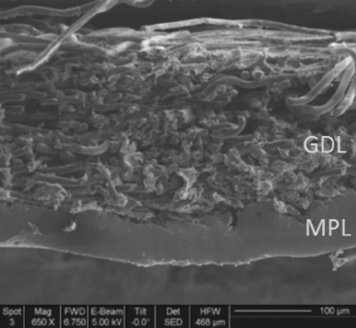
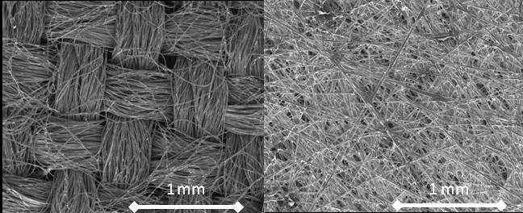
Gas diffusion layer
Distributes gases
Electrically conductive
(Some) mechanical stability
Often carbon cloth or carbon paper
with microporous layer (MPL)
Water management → MPL PTFE treated

Slide 16
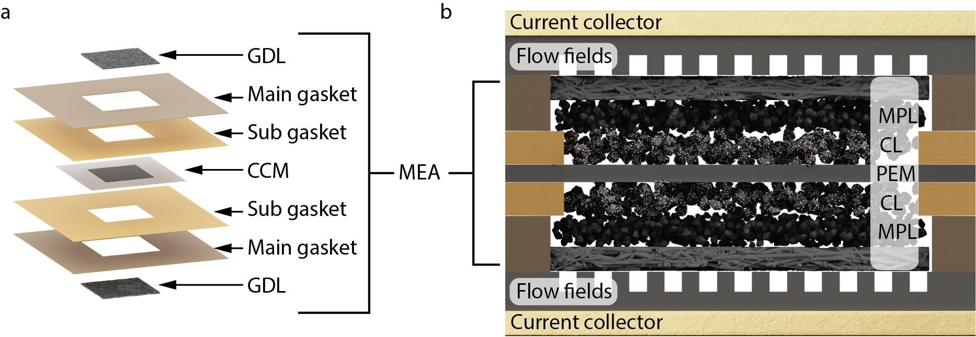
Membrane electrode assembly
CCM: membrane with anode and cathode catalyst layer coated on either side
CCM + GDL held together with gaskets
Sandwiched between flow fields and current collecors

Slide 17
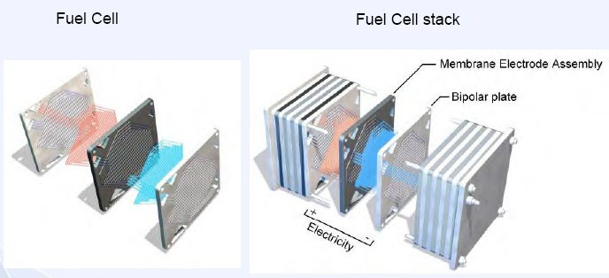
The Fuel Cell Stack
Many Fuel Cells are connected in series to form a “stack”
From the stack: Current depends on the area of the electrode in one cell Voltage depends on the number of cells connected in series Power = Current ∙ Voltage
37
2022-01-21

Slide 18
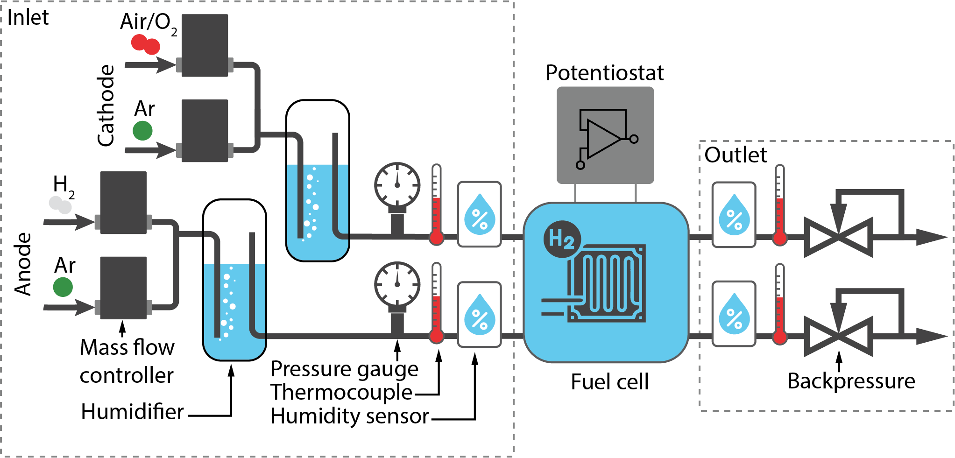
Surrounding system
+ Heating (not shown here)

Slide 19
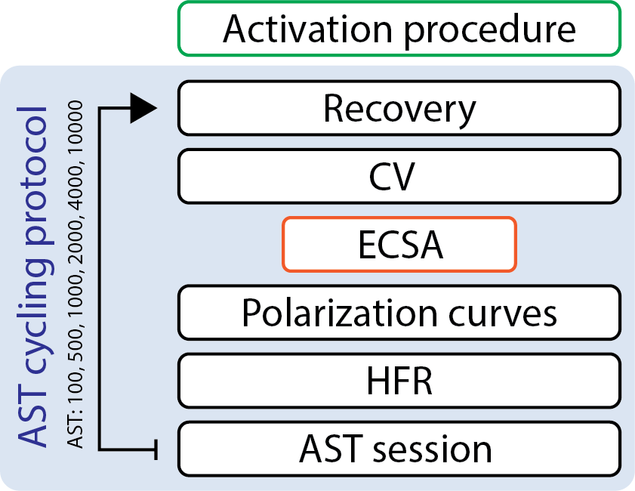
Electrochemical protocol
Activation procedure
Recovery
Cyclic voltammograms (CVs)
Characterize the surface
ECSA
Polarisation curves
Characterise performance
Accelerated stress test
Simulate ’real-life’ degradation in a shorter time period

Slide 20
Electrochemical methods
Activation
Potenital hold at
0.6 V for 45 min
0.95 V for 5 min
0.85 V for 10 min
Recovery
Potential hold at 0.2 V for 2 h
Increases performance
Remove/reducing impurities and contaminants from production
Changes membrane morphology
H2/Ar
80 °C
100% RH
X 10
H2/Ar
60 °C
100% RH
Recovers reversible losses
Reduces contaminants

Slide 21
Electrochemical methods
Cyclic voltammetry (CV)
Potential scan
From 0.07 V to 1.0 V
50 mV/s
Study redox reactions and electrochemical behaviour of electrode and electrolyte.
Measure electrochemical surface area
H2/Ar
40 °C
100% RH

Slide 22
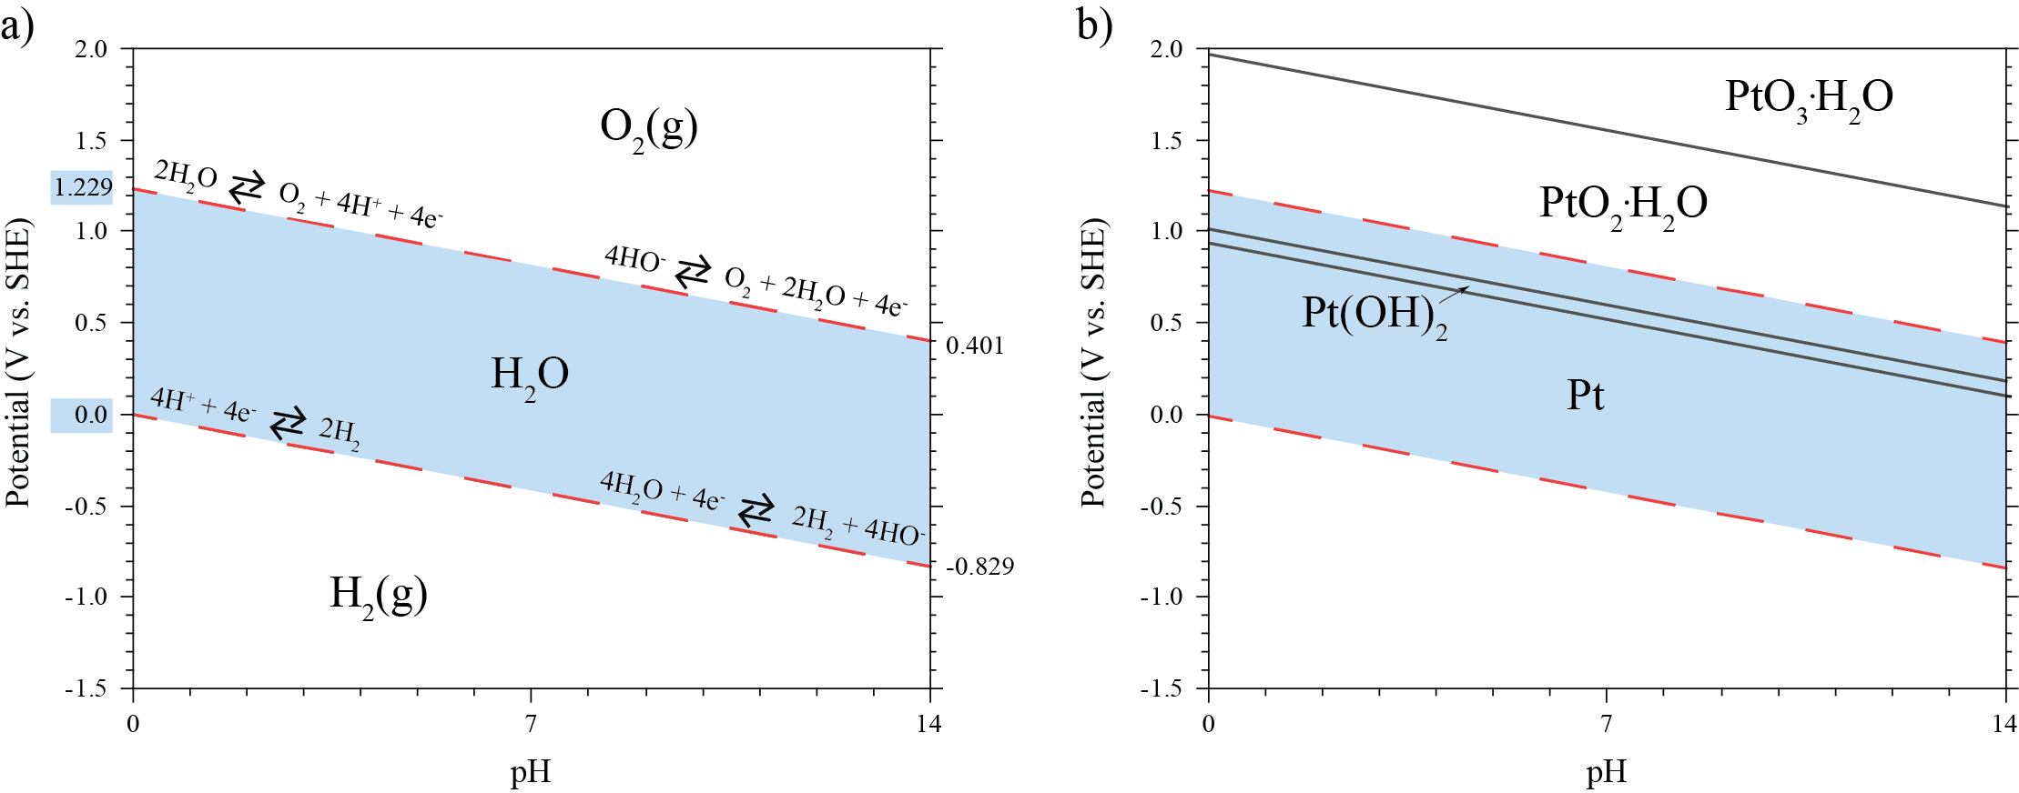
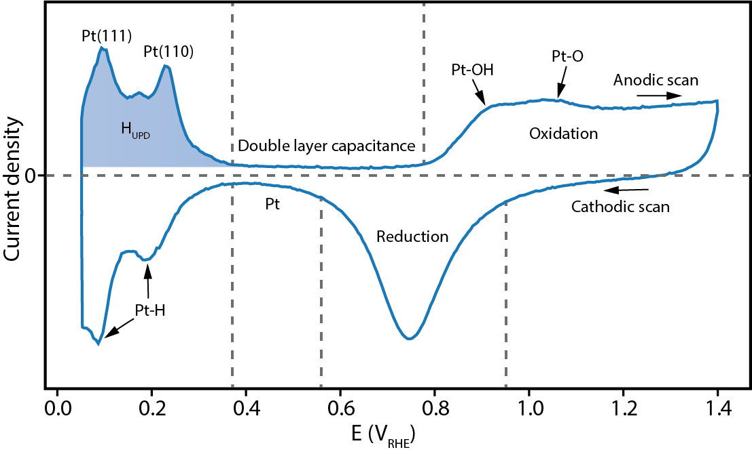
CV of Pt in acid

Slide 23
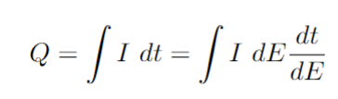
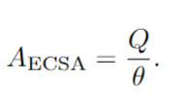
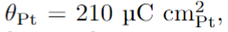
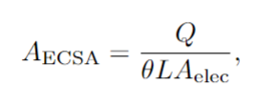
Electrochemical surface area (ECSA)
Total charge:
Deduct charge from double layer
ECSA:
Where
Surface charge of a full H⁺ layer on polycrystalline Pt
L is surface load (0.4 mg/cm²)
A is electrode area (5 cm²)
Often used in
fuel cell research:

Slide 24
Electrochemical methods
Polarisation curves
CV
H2/O2 at anode/cathode
Study reaction kinetics
Gives which overpotential is needed to reach a specific current density

Slide 25
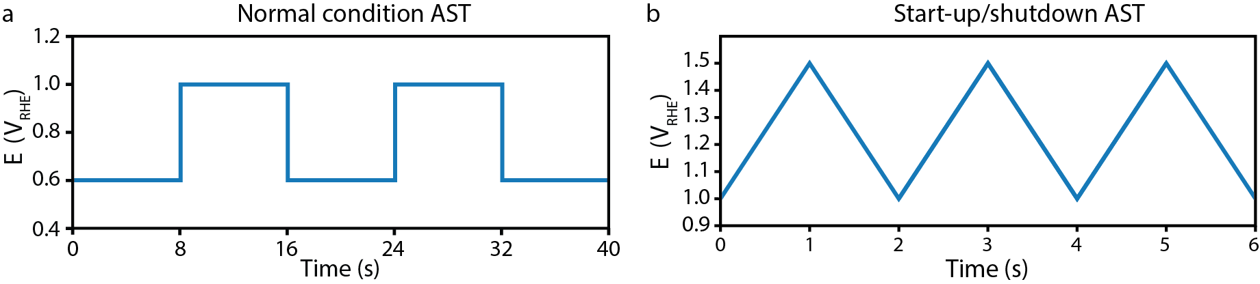
Electrochemical methods
Accelerated stress test
Increases degradation processes
Different ASTs aimed at different operation conditions
Potential hold, potential cycling, RH cycling, temperature cycling etc

